Slide 1
Good morning my dear students.

Slide 2
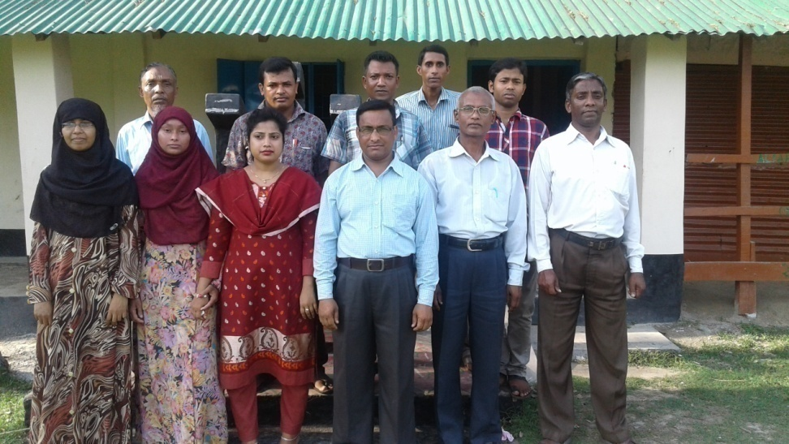
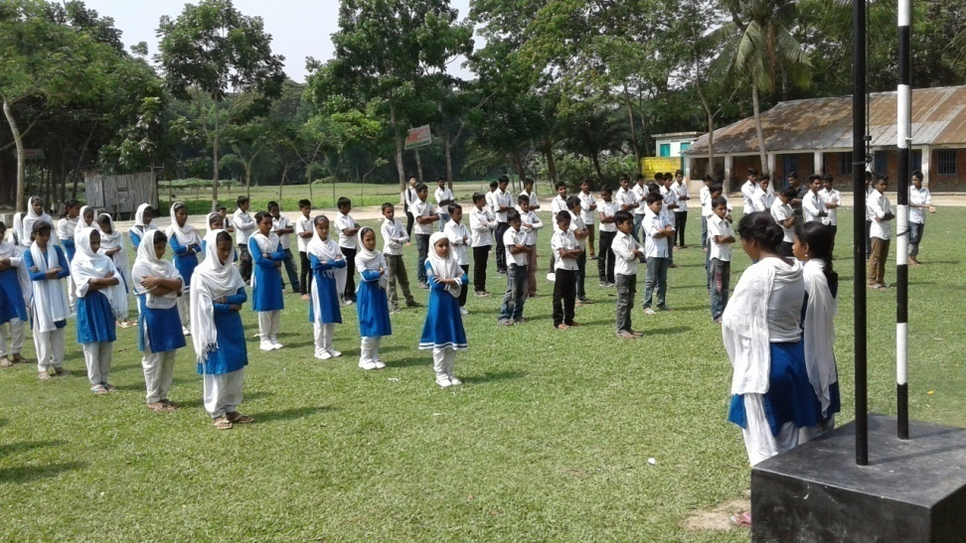
School Identity

Slide 3
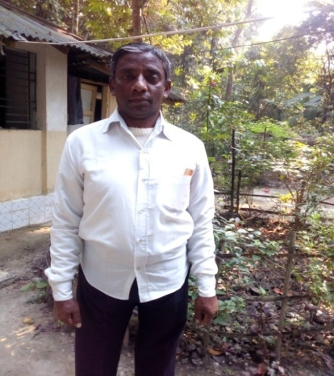
Shanti Ranjan Chakraborty
Senior Teacher in English
Shanuher M A Secondary School Ujirpur,Barisal.
Class-Six-ten
English 1st Paper
Time:50Min.
Date:28/09/2017

Slide 4
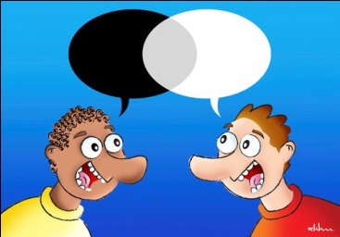
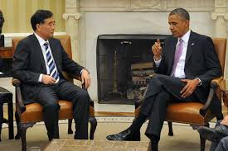
What are they doing?
Dialogue

Slide 5
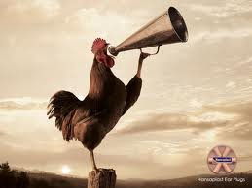
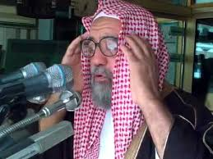
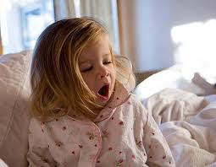
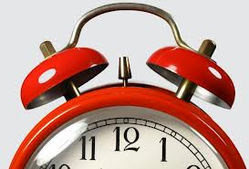
Early Rising

Slide 6
Our Today’s Lesson is-
A Dialogue on
“Early Rising”

Slide 7
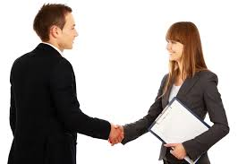
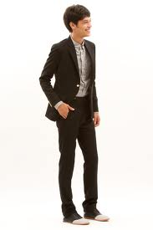

Hi friend, How are you?
I am fine and you?

Slide 8

I am also fine.
Why are you here so early?

Slide 9

I always get up early in the morning.
But why?

Slide 10

I know that early rising is good for health.
What do you mean?

Slide 11
I mean it is a good habit.
What is the benefit of early rising?

Slide 12
There is much
benefit of it.
Do you explain?

Slide 13
Why not?
Please.

Slide 14
An early riser gets enough time. He can say his morning prayer. He can enjoy morning air, can take some physical exercise.
Anything more?

Slide 15

He can enjoy the chirping of birds, can have a walk on the grass.
But can he enjoy the morning sweet bed?

Slide 16
Do you think it
very essential?
Yes, I like to enjoy morning bed very much.

Slide 17

But do you know that early rising is more important than morning bed?
It is my personal belief.

Slide 18

Your belief is somewhat wrong.
So what?

Slide 19

I mean the man who rises up late cannot perform his duty timely. He cannot feel relax with his works.
You have told the right . I don’t perform my duty timely and I have realized that late rising is the cause of it. What is your suggestions about early rising?

Slide 20
We all should rise early and should be habituated to early rising.
I will do that. Thank you my friend.

Slide 21
You are most welcome.

Slide 22
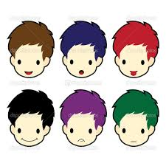
Group Work

Slide 23
Evaluation
Answer the following questions-
What is early rising?
Who is an early riser?
What is the benefit of early rising?
Why should we rise early?

Slide 24
Homework
Write a paragraph on
“Early Rising”

Slide 25
Verse Universal
Early to bed and early to rise makes a man healthy ,wealthy and wise.

Slide 26

Bye bye
যাই যাই

Slide 27
Learning outcomes
After we have studied this lesson we will be able to-
know information
ask and answer questions
have the habit of rising early
write a dialogue.

